Slide 1
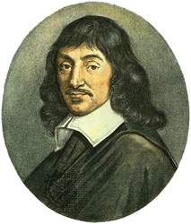
René Decartes: the man
March 31, 1596- February 11, 1649
Jesuit-educated, AB & JD
November 1619: Descartes’ grand vision
Discourse 1637
Principles 1644
Notes:
Discourse on the Method, Trans. Donald A. Crass. Cambridge: Hackett Publishing Company, 1998.
http://media.web.britannica.com/eb-media/33/8433-004-8E2D30AB.jpg

Slide 2
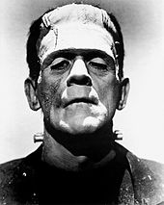
Descartes and Frankenstein
After his three dreams, does René Descartes’ (1596-1650) obsession with developing a mirabilis scientiae fundamenta foreshadow the iconic monster in Mary Shelley’s “Dr. Frankenstein” of two hundred years later? How, yes or no?
VS.

Slide 3
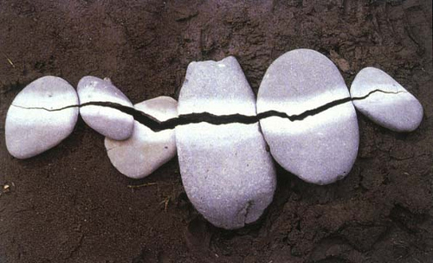
Similarities:
D, like Dr. F, loved automata (examples), D built Francine, human doll
Both Shelley and Descartes inspired by dreams
Science as a means of CONTROL
Both were passionate about the intersection of human anatomy and mechanistic logic
Differences:
Motives for and desired goals of their science (Dr. F wants power and immortality, D craves knowledge)
Subvert and dominate nature vs. elucidate and exalt natural logic

Slide 4
Time and Mechanism
Reason for Descartes=the ultimate tool to reveal the hidden mechanism of all forces of the universe
Any mechanism can be known; once constituent parts are carefully studied and dissected, their collaborative function, logically, can be replicated
- The key for Descartes: the human body, automata and the universe itself have one thing in common: they are ALL machines, thus understanding their anatomical organization is essential
The CLOCK = a central metaphor for D’s discussion of nature AND a key analogue for the functioning of the human body
His is a philosophy of SPACE, not TIME
Time as a mode of thinking, rather than a proper mechanism
He was concurrent with a “horological revolution”
(Textbook, 252.)

Slide 5
Discussion Questions
"I saw the pale student of unhallowed arts kneeling beside the thing he had put together. I saw the hideous phantasm of a man stretched out, and then, on the working of some powerful engine, show signs of life, and stir with an uneasy, half-vital motion. Frightful must it be; for supremely frightful would be the effect of any human endeavor to mock the stupendous Creator of the world.”
- Mary Shelley, introduction to Frankenstein, or the Modern Prometheus, 1818.
Do you think it is significant that Descartes’ lifelong ambition to develop an “all-powerful,” unified rational science was inspired by an irrational series of visions, ostensibly a divine intervention in the world? Do you think Descartes considered this quandary? Why or why not? Consider the context of religion in Europe during the 17th Century.
Given what we’ve already discussed about Shelley’s narrative in Frankenstein, do you think that time plays a role in that story? If so how? How might the clock, natural philosophy (specifically regarding “progress”) and human procreation generally figure into the narrative?
Compare and Contrast Descartes’ and Shakespeare’s visions of the clock that we have discussed over the past two weeks. Does each see the clock as a metaphorical, spiritual, or physical force?

Slide 6
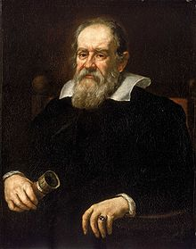
Discourse on the Method, 1637
First publication by Descartes
Introduction to essays and
La Dioptrique (optics)
Las Météores (meteorology)
La Géométrie (geometry)
Summarizes ideas of Le Monde,
which went unpublished after Galileo’s condemnation in 1633

Slide 7
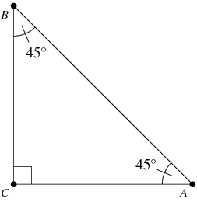
Part IV
Assumptions made in “the search after truth”
“I think, therefore I am.”
Soul separate from body
Truth = what we conceive “clearly and distinctly”
God = perfect being
God & geometric proofs
Senses and imagination are misleading
Notes:
http://mathworld.wolfram.com/images/eps-gif/IsoscelesRightTriangle_1000.gif

Slide 8
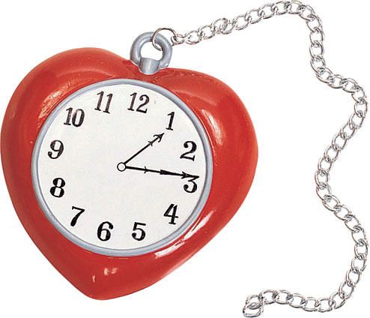
Part V
Summarizes Le Monde, an exploration of natural laws
Creation of hypothetical world
Planets, stars
Earth
Light
Humans and animals
Anatomy and movement of heart and veins
Heart as clock
Notes:
http://images.onlinejokeshop.co.uk/images/shop/product_images/38988/528.jpg

Slide 9
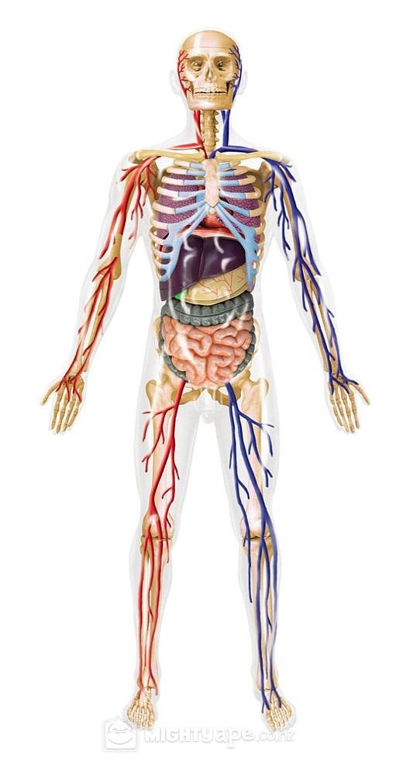
Laws of mechanics identical to laws of nature
Blood moving to brain
Body = machine made by God
…but machines cannot perfectly imitate men
Can’t express themselves
Lack reason
“Brutes” act like clocks

Slide 10
Part V: Human Exceptionalism
Ability for self-expression
Rational soul
Consciousness
Afterlife
Notes:
http://images.onlinejokeshop.co.uk/images/shop/product_images/38988/528.jpg

Slide 11
Part VI
Reveals why treaty went unpublished
Fear “that among my own opinions one might be found which should be misunderstood”
Notes:
http://funeralspot.com/images/infositepics/funeralspot-catholic-funerals(1).jpg

Slide 12
Discussion Questions
How does Descartes’ view of God change from Discourse to Principles? Does it change?
How much should scientists rely on their senses / intuition? Do you think observation is ever perfectly objective?
How does time, and the clock in particular, factor into Descartes’ conceptions of living creatures?

Slide 13
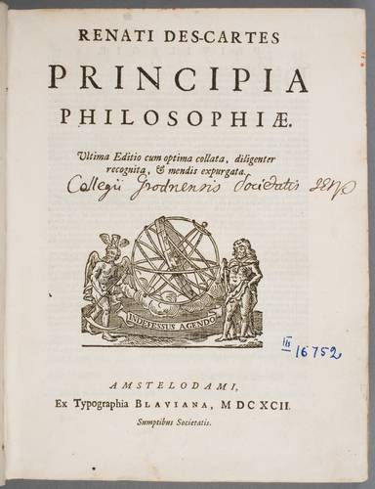
The Principles of Philosophy

Slide 14
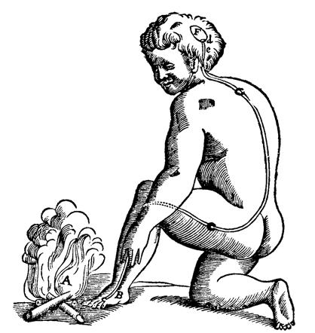
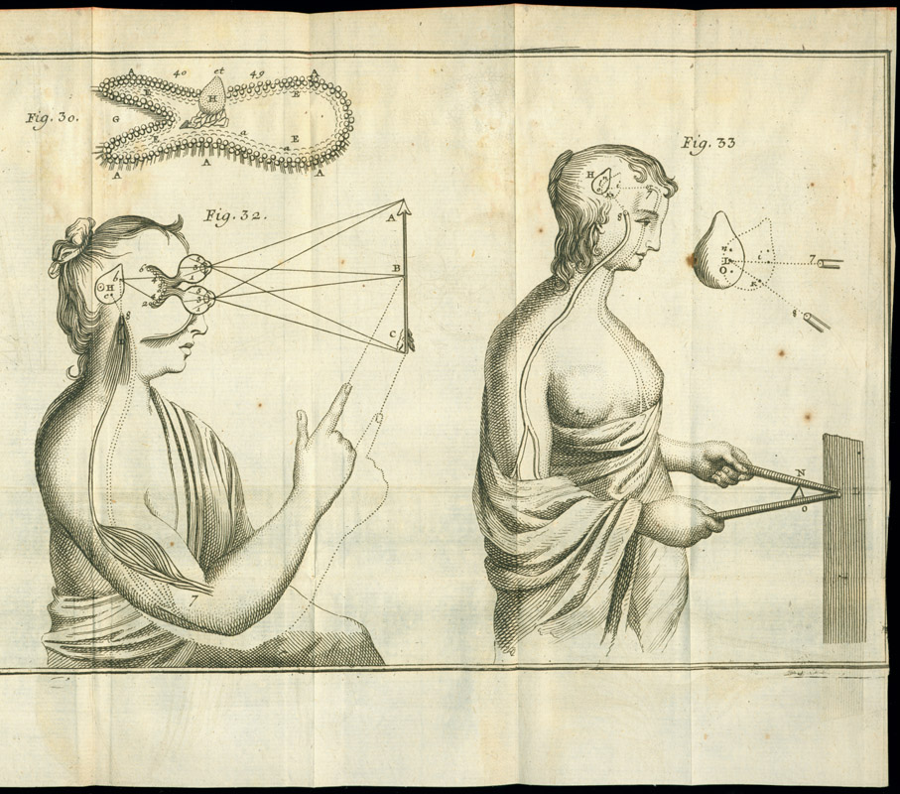
Extension
“The nature of the body consists...in extension alone.”
Primary characteristic of matter
For Descartes, it meant that the object had the property of existing in more than one dimension at the same time
Possible to conceive of extension without other properties (color, hardness), but not extension
Not shape, but length, depth, and breadth

Slide 15
Extension

Slide 16
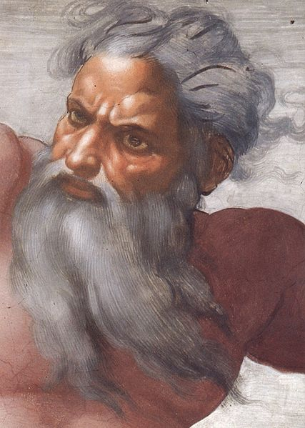
God
“Not fear to fall into error by imagining His works to be too great, too beautiful, too perfect...”
Confidence in the ability to master the physical world
The clock and the control of time is that example of harnessing the chaos of the physical world

Slide 17
Sensation
The perception and feeling of the physical world around us
Inform man of the harms and benefits of the world
Mix of our emotions and the senses
Pain, joy, sight, smell, auditory, etc.

Slide 18
Union of the Body and Mind
Sensations, the crossroads of the emotions and the senses, lie at the union of the body and the mind
Mind and body are separate and independent
Possible for the immaterial (mind) and the material (body) to intersect → Time and Humans

Slide 19
Questions
How does time relate to extension?
Why do we not consider shape to be extension?
Why does Descartes play down the power and awe of God?

Slide 20
References
Descartes, René. Principles of Philosophy. Dordrecht, Holland: Reidel, 1983. Print.
Lahr, C. Dwight, and Beatriz Pastor. A Matter of Time (draft manuscript). 2012.
Shakespeare, William. The Merchant of Venice. London, 1605.
Shelley, Mary. Frankenstein; or the modern Prometheus. London, 1818.
Discourse on Method. Trans. Donald A. Crass. Cambridge: Hackett Publishing Company, 1998.
“Discourse on Method” in Descartes: Key Philosophical Writings. Trans. Elizabeth S. Haldane and G.R.T. Ross. Hertfordshire: Wordsworth Editions Limited, 1997.

