Slide 1
Mathematical, Religious, and Psychological Time
Jenieri Cyrus, Richard Fu, Maurice Johnson, Alicia Rodriguez, Emma Smith

Slide 2
The Confessions of St. Augustine
An autobiographical book of detailing Augustine's life from his time as a "sinful youth" to his conversion to Christianity.
Written as a direct address to god.
Record of Augustine's development of thought.

Slide 3
Main Topics of Book XI
Nature of time
Eternity of God
Temporality of Earth
Human understanding of time: Past, Present, and Future

Slide 4
When did time start?
Genesis
Literal v. Spiritual
Mechanism of Creation
"And God Said"

Slide 5
Is creation temporal?
Eternal Design
"Beginning"
Impossibility of Creation...
"...everything which begins to be and ceases to be begins and ends its existence at that moment when, in the eternal reason where nothing begins or ends, it is known that it is right for it to begin and end."

Slide 6
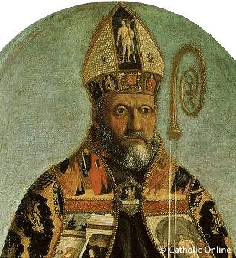
The Nature of Time
3 divisions of time (Past, Present and Future)
"indeed we cannot truly say that time exists except in the sense that it tends toward non-existence"

Slide 7
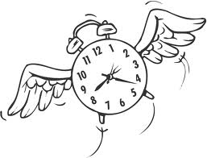
The Nature of Time
"What, then, is time? I know well enough what it is, provided that nobody asks me; but if I am asked what it is and try to explain, I am baffled."

Slide 8
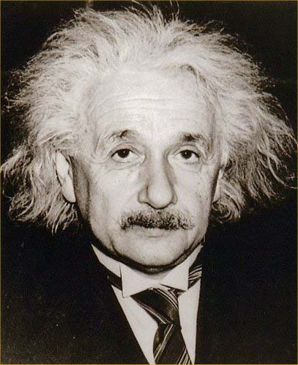
Albert Einstein and the Theory of Relativity
Relative theory made it difficult to conduct experiments with accuracy

Slide 9
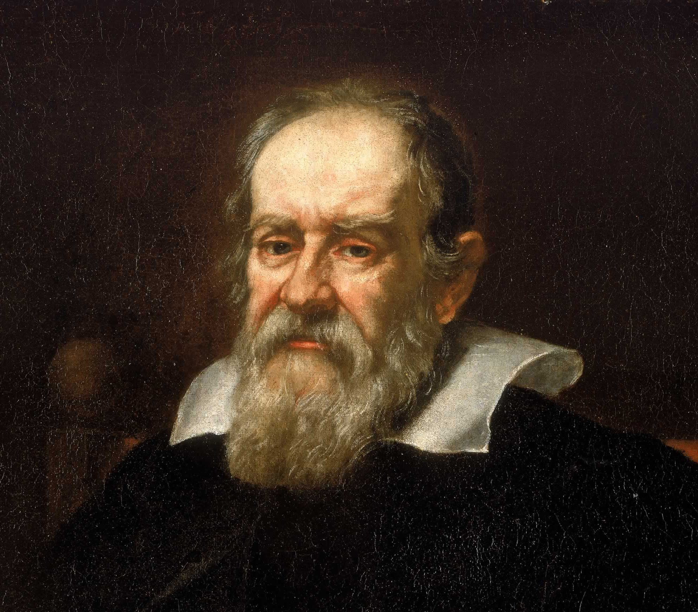
Galileo Galilei
No Instruments or techniques to measure time

Slide 10
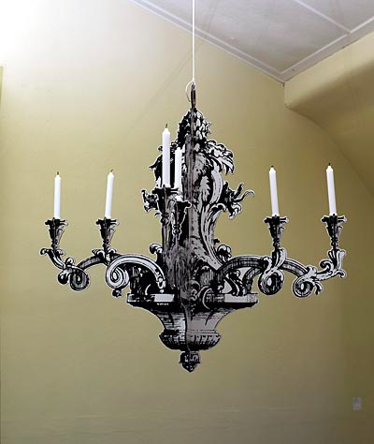
Highest point of swing was the same regardless of displacement
Heartbeats measured time during the chandelier model
Principle of pendulum was the blueprint for the clock

Slide 11
Aristotle and Galileo
"If I have seen further [than certain other men] it is by standing upon the shoulders of giants."

Slide 12
Determining Acceleration

Slide 13
The Marriage of Mathematical, Psychological, and Religious Time

Slide 14
Questions??

