Slide 1
Math 5: Composition
Michael Blum

Slide 2
Math 5: Composition
Michael Blum

Slide 3
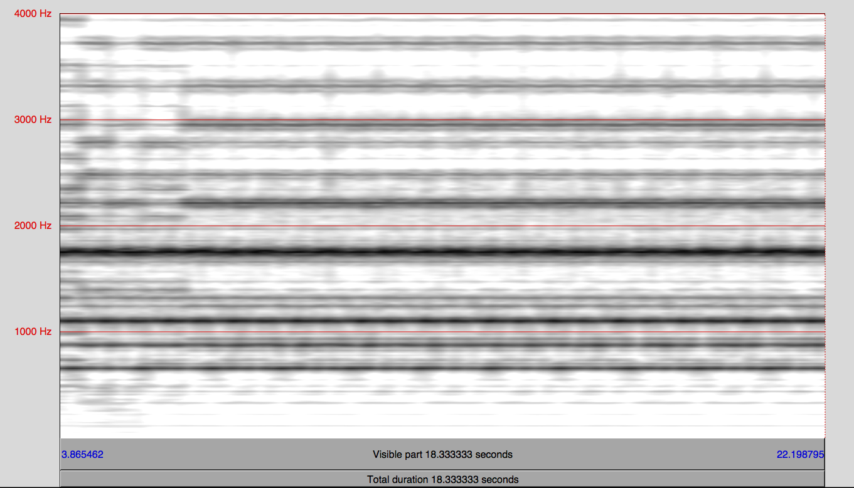
Organ Pedal

Slide 4
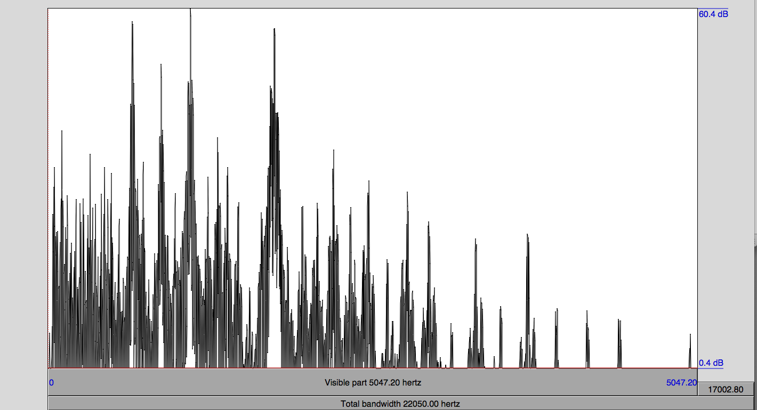
Organ Pedal

Slide 5
Organ Pedal
Ratio to f₀ | Hz | dB | n from A440 | n/12 | Rounded | n from nearest A | Note | Degree | Note Frequency
1 | 51.35 | 26 | -37.19 | -3.099067342 | -3 | 1.19 | G# | 1 | A | 5
1.3 | 70.2 | 12 | -31.78 | -2.647960588 | -2 | 7.78 | C# | 2 | A# | 1
1.6 | 84.87 | 9.2 | -28.49 | -2.374176941 | -2 | 4.49 | F | 2 | B | 5
2.1 | 110.53 | 28.7 | -23.92 | -1.993065525 | -1 | 11.92 | A | 2 | C | 1
2.8 | 149.81 | 17.3 | -18.65 | -1.554369595 | -1 | 6.65 | D | 2 | C# | 4
3.4 | 186.47 | 14.2 | -14.86 | -1.238559981 | -1 | 2.86 | F# | 3 | D | 4
4 | 218.42 | 16.7 | -12.12 | -1.010398559 | -1 | 0.12 | A | 3 | D# | 2
4.6 | 248.27 | 14.4 | -9.91 | -0.825593581 | 0 | 9.91 | B | 3 | E | 4
5.1 | 277.6 | 18.3 | -7.97 | -0.664495956 | 0 | 7.97 | C# | 4 | F | 1
5.5 | 298.83 | 16 | -6.70 | -0.558178534 | 0 | 6.70 | D | 4 | F# | 4
6 | 328.92 | 20 | -5.04 | -0.41976679 | 0 | 5.04 | E | 4 | G | 3
6.8 | 369.25 | 18.3 | -3.03 | -0.252905603 | 0 | 3.03 | F# | 4 | G# | 3
7.2 | 393.34 | 18 | -1.94 | -0.161726618 | 0 | 1.94 | G | 4
7.6 | 414.84 | 15 | -1.02 | -0.084948514 | 0 | 1.02 | G# | 4
8 | 439.42 | 25 | -0.02 | -0.001902989 | 0 | 0.02 | A | 4
8.5 | 465.61 | 13.6 | 0.98 | 0.08161852 | 0 | 0.98 | A# | 4
9 | 492.84 | 27.9 | 1.96 | 0.163615829 | 0 | 1.96 | B | 4
10.1 | 555.16 | 14.8 | 4.02 | 0.3354001 | 0 | 4.02 | C# | 5
10.7 | 587.08 | 7.9 | 4.99 | 0.416053586 | 0 | 4.99 | D | 5
12 | 659.88 | 51.1 | 7.02 | 0.584700169 | 0 | 7.02 | E | 5
13.5 | 740.53 | 38.2 | 9.01 | 0.751054659 | 0 | 9.01 | F# | 5
14.3 | 786.09 | 22.2 | 10.05 | 0.837190973 | 0 | 10.05 | G | 5
15.2 | 831.63 | 15.3 | 11.02 | 0.918438279 | 0 | 11.02 | G# | 5
16.1 | 880.33 | 46 | 12.01 | 1.000540909 | 1 | 0.01 | A | 5
18 | 988.15 | 30.3 | 14.01 | 1.167226534 | 1 | 2.01 | B | 5
20.2 | 1108.9 | 53.8 | 16.00 | 1.333553841 | 1 | 4.00 | C# | 6
21.4 | 1173.61 | 23.1 | 16.98 | 1.41537764 | 1 | 4.98 | D | 6
22.7 | 1244.31 | 25.1 | 18.00 | 1.499770526 | 1 | 6.00 | D# | 6
24 | 1319.2 | 36.8 | 19.01 | 1.584087875 | 1 | 7.01 | E | 6
25.5 | 1397.23 | 25.5 | 20.00 | 1.666994095 | 1 | 8.00 | F | 6
27 | 1481 | 30.7 | 21.01 | 1.750996212 | 1 | 9.01 | F# | 6
28.6 | 1569.51 | 15.2 | 22.02 | 1.834738792 | 1 | 10.02 | G | 6
30.3 | 1664.63 | 19.2 | 23.04 | 1.919626114 | 1 | 11.04 | G# | 6
32.1 | 1763.22 | 51.1 | 24.03 | 2.002637065 | 2 | 0.03 | A | 6
35.9 | 1974.09 | 21.1 | 25.99 | 2.165612336 | 2 | 1.99 | B | 6
38.1 | 2091.53 | 26.2 | 26.99 | 2.248983263 | 2 | 2.99 | C | 7
40.4 | 2218.4 | 33 | 28.01 | 2.333944093 | 2 | 4.01 | C# | 7
42.8 | 2350.42 | 29.5 | 29.01 | 2.417343148 | 2 | 5.01 | D | 7
45.3 | 2489.45 | 21.2 | 30.00 | 2.500251611 | 2 | 6.00 | D# | 7
48 | 2637.75 | 22.9 | 31.00 | 2.583732407 | 2 | 7.00 | E | 7
53.9 | 2960.07 | 23 | 33.00 | 2.750055864 | 2 | 9.00 | F# | 7
72 | 3959.58 | 18.5 | 38.04 | 3.16977198 | 3 | 2.04 | B | 7

Slide 6
Motif A
Variation on Motif A
Variation on Motif A
Relationship to Organ Pedal
f₀ = 55 Hz (A₁)
A – 1f, 2f, 4f, 8f, 16f, 32f
B – 4.6f, 9f, 18f, 36f, 72f
C# - 1.3f, 5f, 10f, 20f, 40f
D# - 22.7f, 40.4f
E – 6f, 12f, 24f, 48f
F# - 3.4f, 6.8f, 13.6f, 27f
G# - 1f, 7.6f, 15.2f, 30.3f

Slide 7
Motif B
Relationship to Organ Pedal
f₀ = 55 Hz (A₁)
A – 1f, 2f, 4f, 8f, 16f, 32f
B – 4.6f, 9f, 18f, 36f, 72f
C – 38f
C# - 1.3f, 5f, 10f, 20f, 40f
D# - 22.7f, 40.4f
E – 6f, 12f, 24f, 48f
F# - 3.4f, 6.8f, 13.6f, 27f
G – 7.2f, 14.3f, 28.6f
G# - 1f, 7.6f, 15.2f, 30.3f

Slide 8
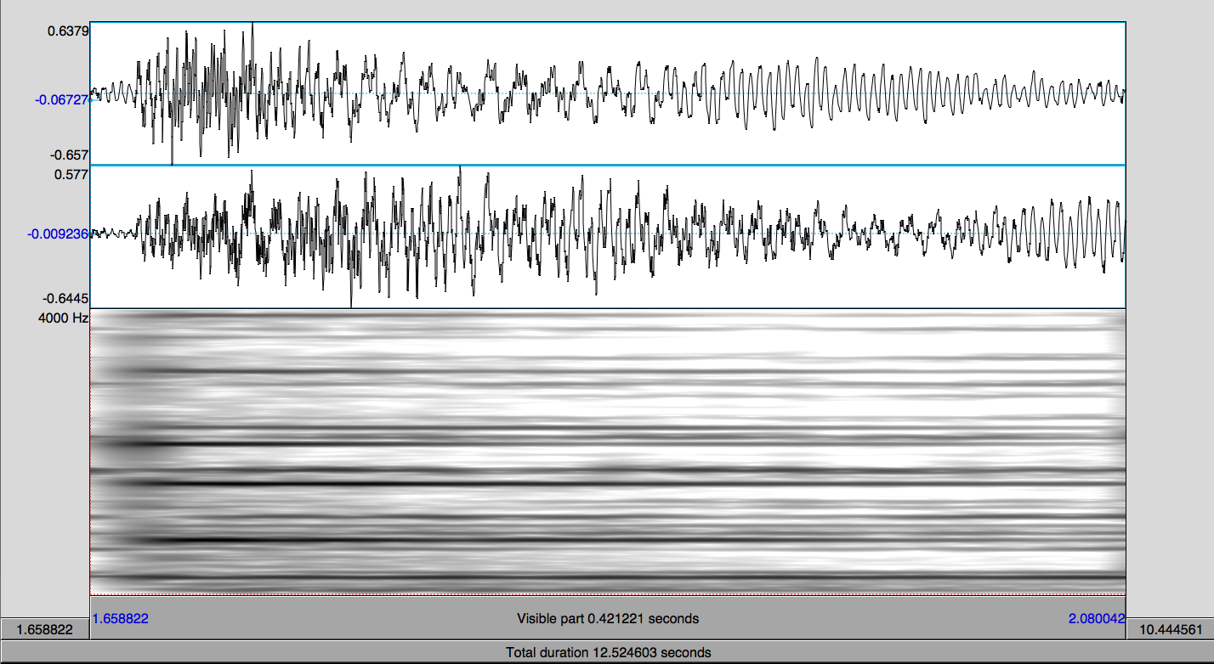
Dissonance in Motif B

Slide 9
Dissonance in Motif B
Strongest Partials (above 25dB)
Frequency (Hz) | Intensity (dB) | % Relative to Previous Partial
41.86 | 34.3 | n/a
60.76 | 31.7 | 31.1%
82.08 | 55.5 | 26.0%
111.87 | 40.8 | 26.6%
125.02 | 42.1 | 10.5%
166.78 | 37.1 | 25.0%
192.48 | 25.9 | 13.4%
207.96 | 29.2 | 7.4%
261.41 | 56.3 | 20.4%
277.18 | 39.8 | 5.7%
290.91 | 25 | 4.7%
329.75 | 36 | 11.8%
783.16 | 47.4 | 57.9%
796.59 | 31.6 | 1.7%
880.41 | 31.8 | 9.5%
982.45 | 25.6 | 10.4%
1109.79 | 32 | 11.5%
1568.21 | 39.6 | 29.2%
Dissonance: ≤15%

Slide 10
Melodic Transformation
(Reflection in the X axis)

Slide 11
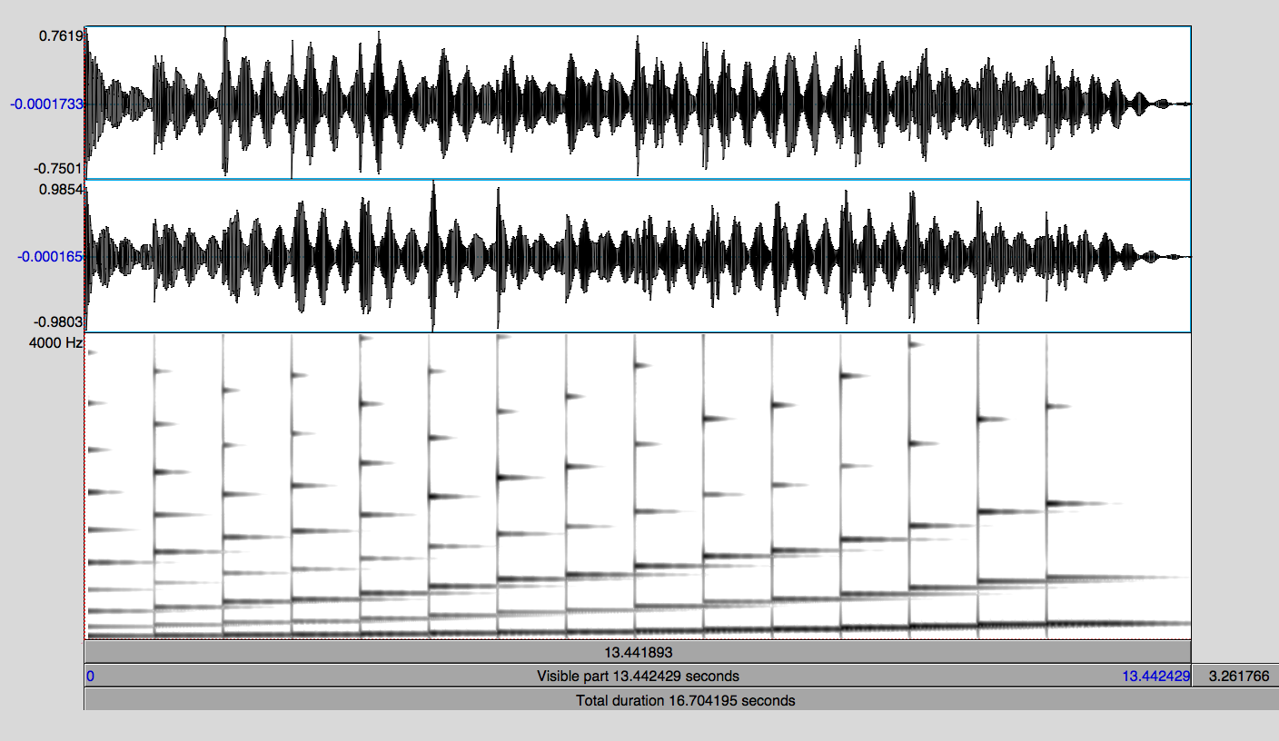
Instrumentation
Vibraphone
Percussive; bell-like; the long sustain of the 1st, 2nd and 3rd partials create beats
Has partials at f₀, 3.26f₀, 7f₀, 12f₀, 18.5f₀, 26.23f₀

Slide 12
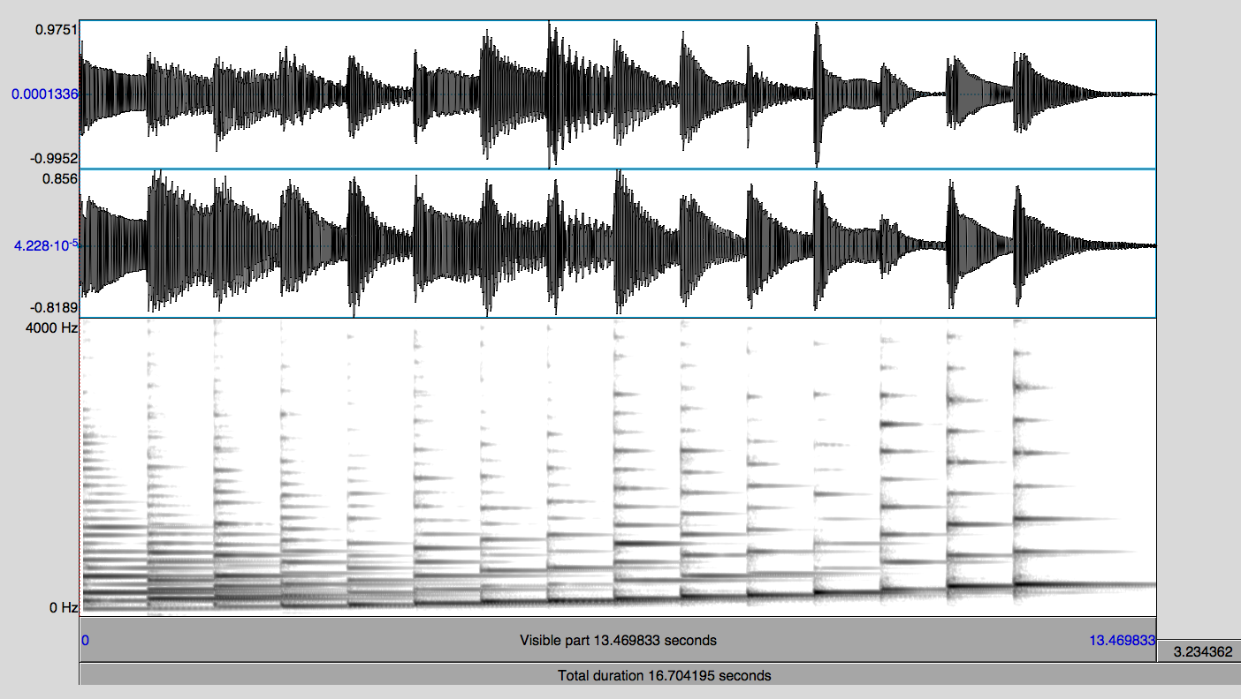
Instrumentation
Harp
Evenly spaced partials, mellow timbre
Has partials at f₀, 2f₀, 3f₀, 4f₀, 5f₀, 6f₀, … (decrease in intensity as they increase in frequency)

Slide 13
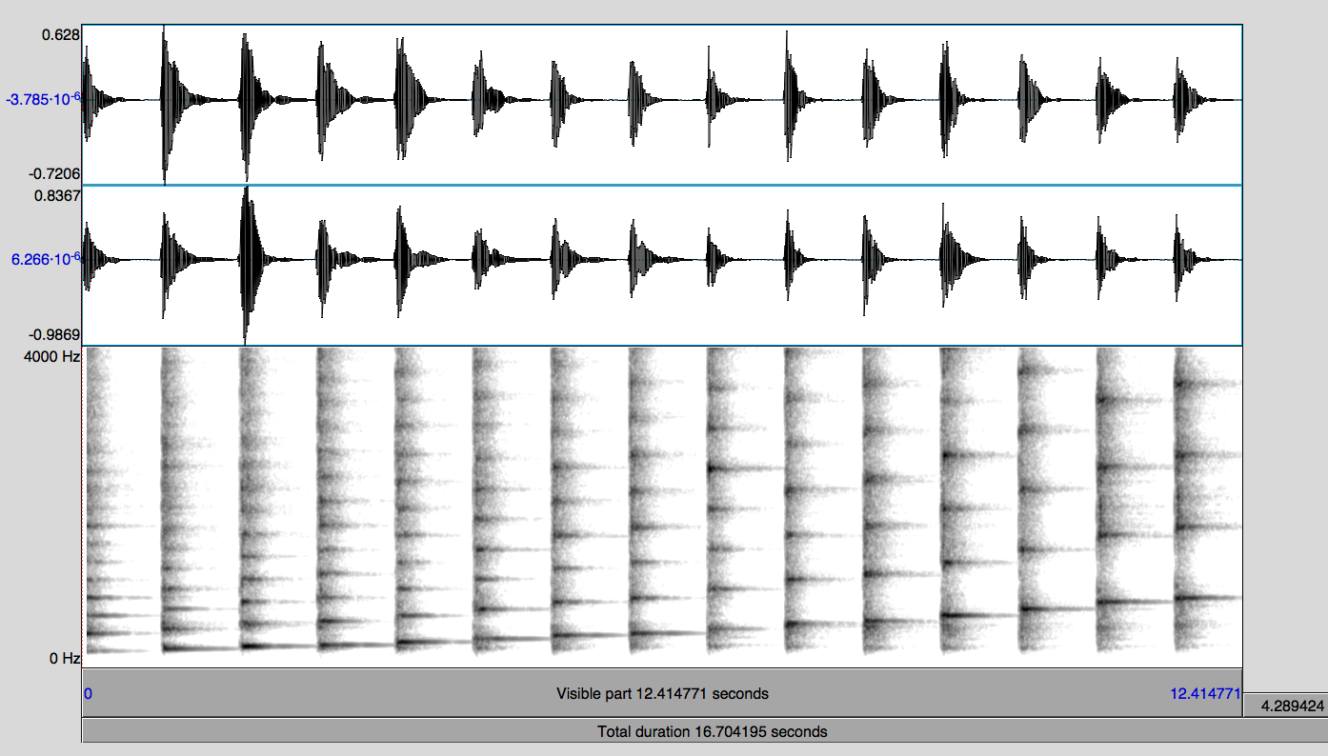
Instrumentation
Pizzicato (Plucked) Strings
Percussive, evenly spaced partials
Strong partials at f₀, 2f₀, 3f₀, 4f₀, 8f₀

Slide 14
Conclusion
What is the tone created by the organ pedal and the dissonances in the melody?
What impact does the timbre of the instruments have on the piece?
What does this piece communicate to you?
What is the contour of the piece?

